Slide 1
The Regional Climate Model Evaluation System: A Systematic Evaluation Of CORDEX Simulations Using Obs4MIPs
Alex Goodman ¹<alexander.goodman@jpl.nasa.gov>,
Duane Waliser¹, and Huikyo Lee¹
Bill Gutowski²
¹: JPL, Caltech ²: Iowa State University
Acknowledgement: 14 CORDEX Domain Teams

Slide 2
Introduction
CORDEX.org
The Coordinated Regional Climate Downscaling Experiment (CORDEX) has helped paved the way for studying climate change at regional and local scales.
Systematic model evaluation studies across the 14 domains (each with multiple simulations and many variables) have been limited, with differences in data publication requirements (e.g. ESGF vs local storage/ftp) and archiving standards (e.g. use of CF-compliant netCDF)

Slide 3
Project Goals
Leverage NASA-sponsored RCMES and NASA- co-sponsored obs4MIPs to benefit WCRP/CORDEX
Make it easy to perform systematic evaluations with CORDEX domains, models and variables
Utilize the Regional Climate Model Evaluation System (RCMES, http://rcmes.jpl.nasa.gov)
Leverage NASA satellite observational datasets in evaluations
Utilize Obs4MIPs (https://www.earthsystemcog.org/projects/obs4mips/)
Increase communication and collaboration between CORDEX domains

Slide 4
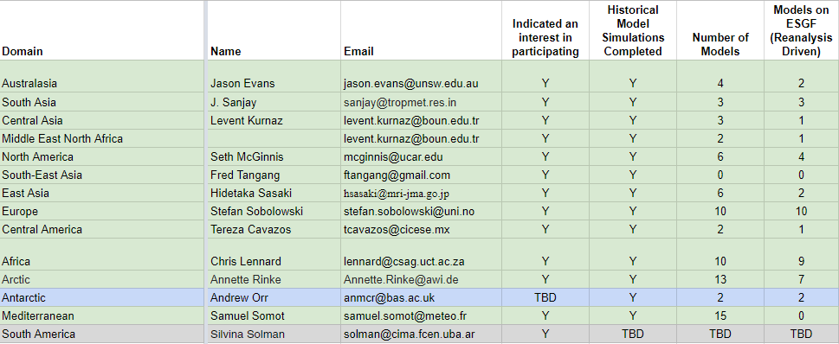
Reaching out to CORDEX domains (10/2016)
https://docs.google.com/spreadsheets/d/14j1z-ItZphsgiJOyUkPGhI1cvY6JGkDjlcP0lTnP5EM/edit#gid=0

Slide 5
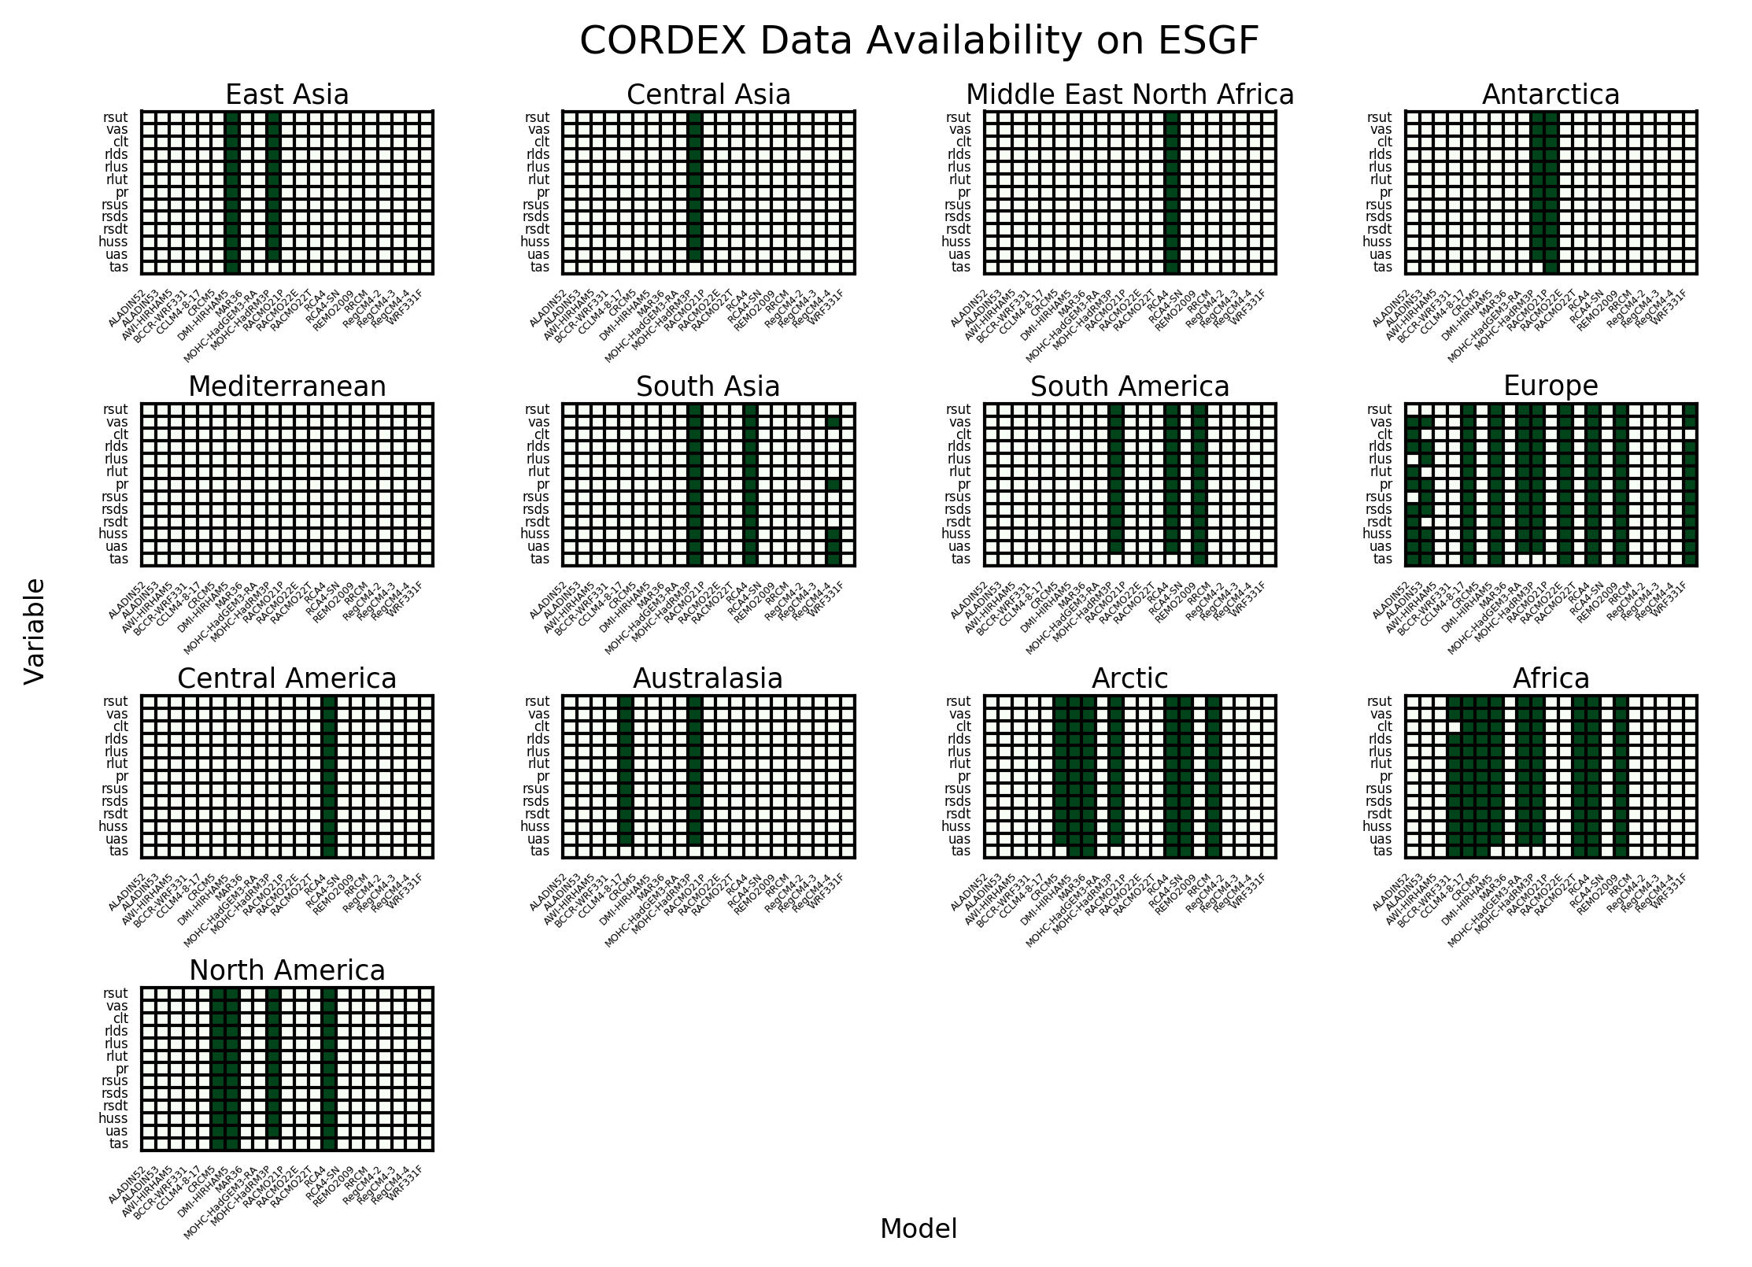
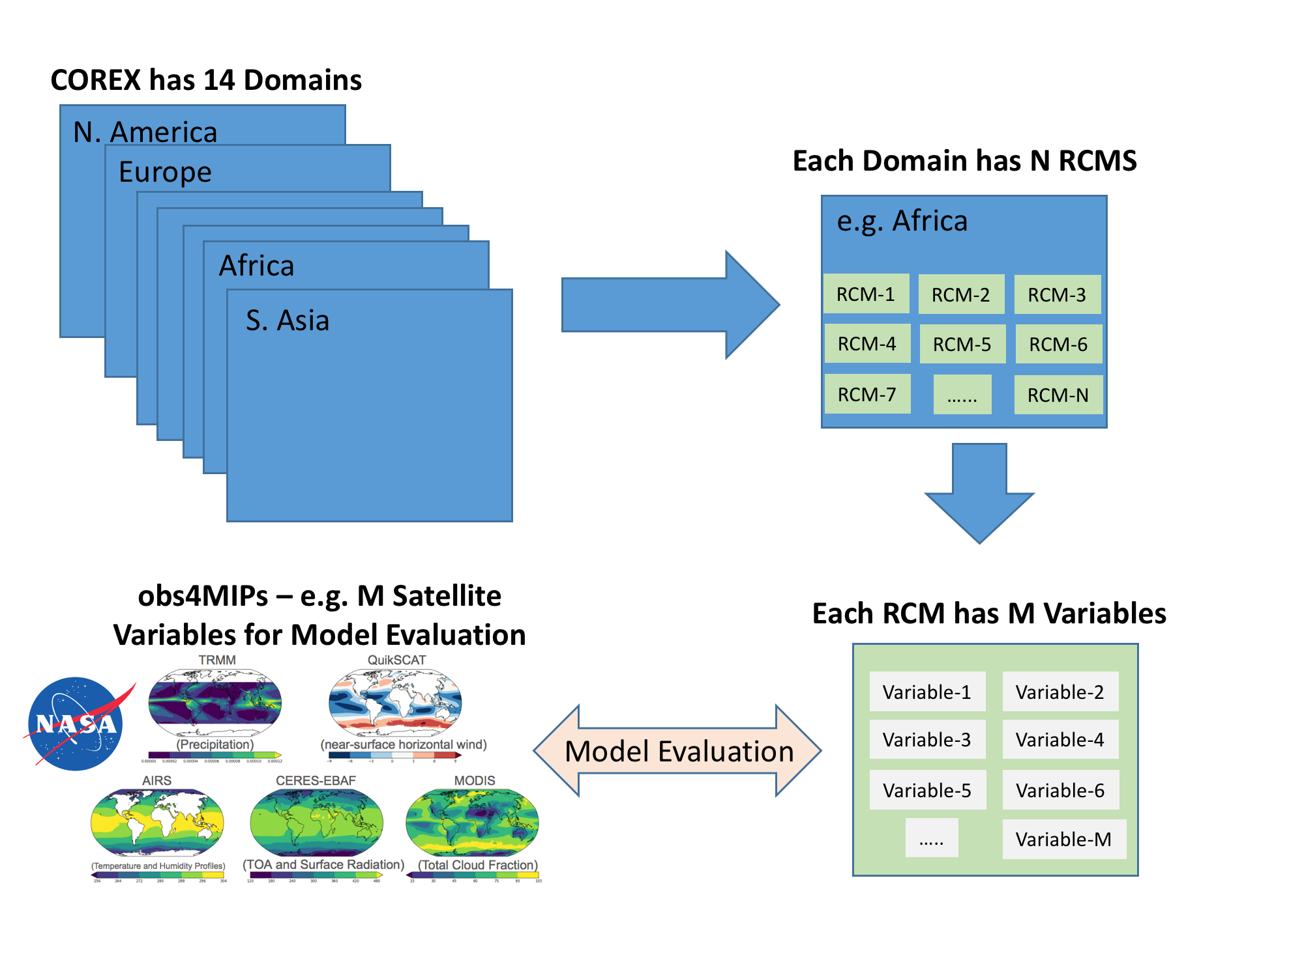
ERA-Interim Reanalyses Forced RCM simulations Available on ESGF
Schematic of Multi-Domain, Multi-Model and Multi-Variate CORDEX Model Evaluation with Obs4MIPs
RCMES
Starting Analyses on these Domains
Multiple
Metrics

Slide 6
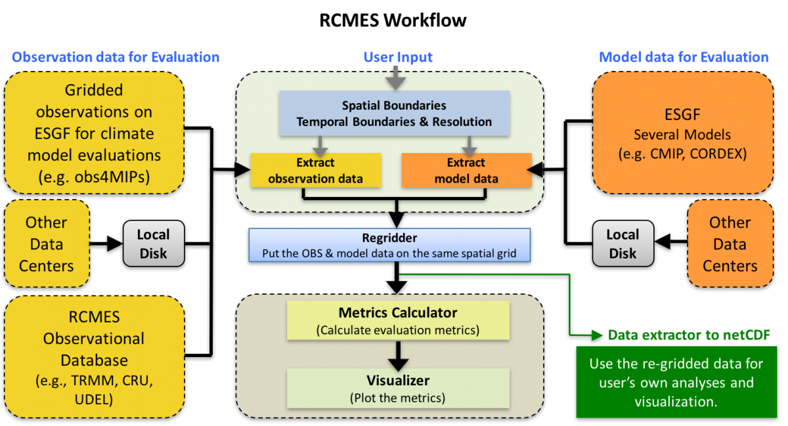
More on RCMES
RCMES was originally designed and funded by NASA for use in the National Climate Assessment (NCA)
Website: http://rcmes.jpl.nasa.gov

Slide 7
Key Deliverables
Evaluation results will be available to the public on our website (rcmes.jpl.nasa.gov)
Results will be performed on annual, DJF, and JJA seasons.
Results sorted by domain > obs4Mips-variable > season > models
Key products:
Metrics plots for Bias, Pattern Correlation, and RMSE.
RCMES configuration file for reproducibility.
RCMES software is open source and available through GitHub (https://github.com/apache/climate)

Slide 8
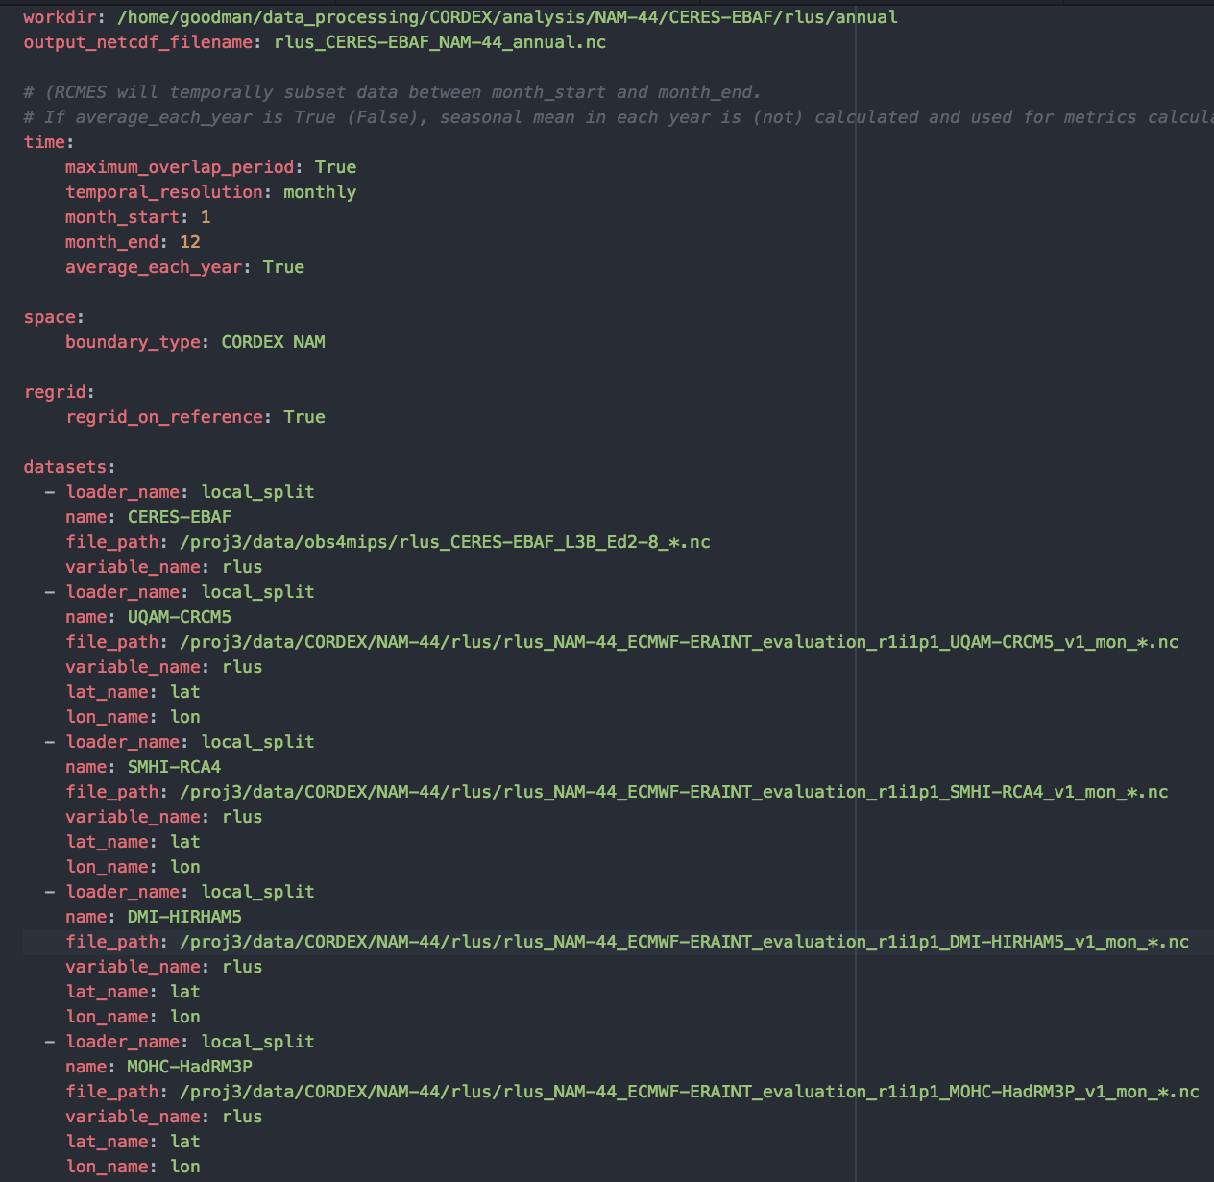
Why we need “Systematic Evaluation”
Season
Domain
This Config file (namelist file) is necessary to run each evaluation combination (CORDEX Domain, Season and Variable), forming a large “evaluation matrix”.
14 variables x 13 domains x 3 seasons x ~10 models > 5000 evaluations
Writing that many Config files manually would be cumbersome/prohibitive.
Observations
Models

Slide 9
Solution: Extract metadata from input filenames
rlus_NAM-44_ECMWF-ERAINT_evaluation_r1i1p1_UQAM-CRCM5_v1_mon_*.nc
Variable
Domain
Model
User Input:
Dataset Locations
(obs4mips, CORDEX)
Evaluation Groups
(Season, Domain, Variable)
Config File
RCMES
We can group all models and obs datasets together by common attributes (domain and variable) to form a unique evaluation, and therefore automatically generate Config Files using only the dataset locations as user input.

Slide 10
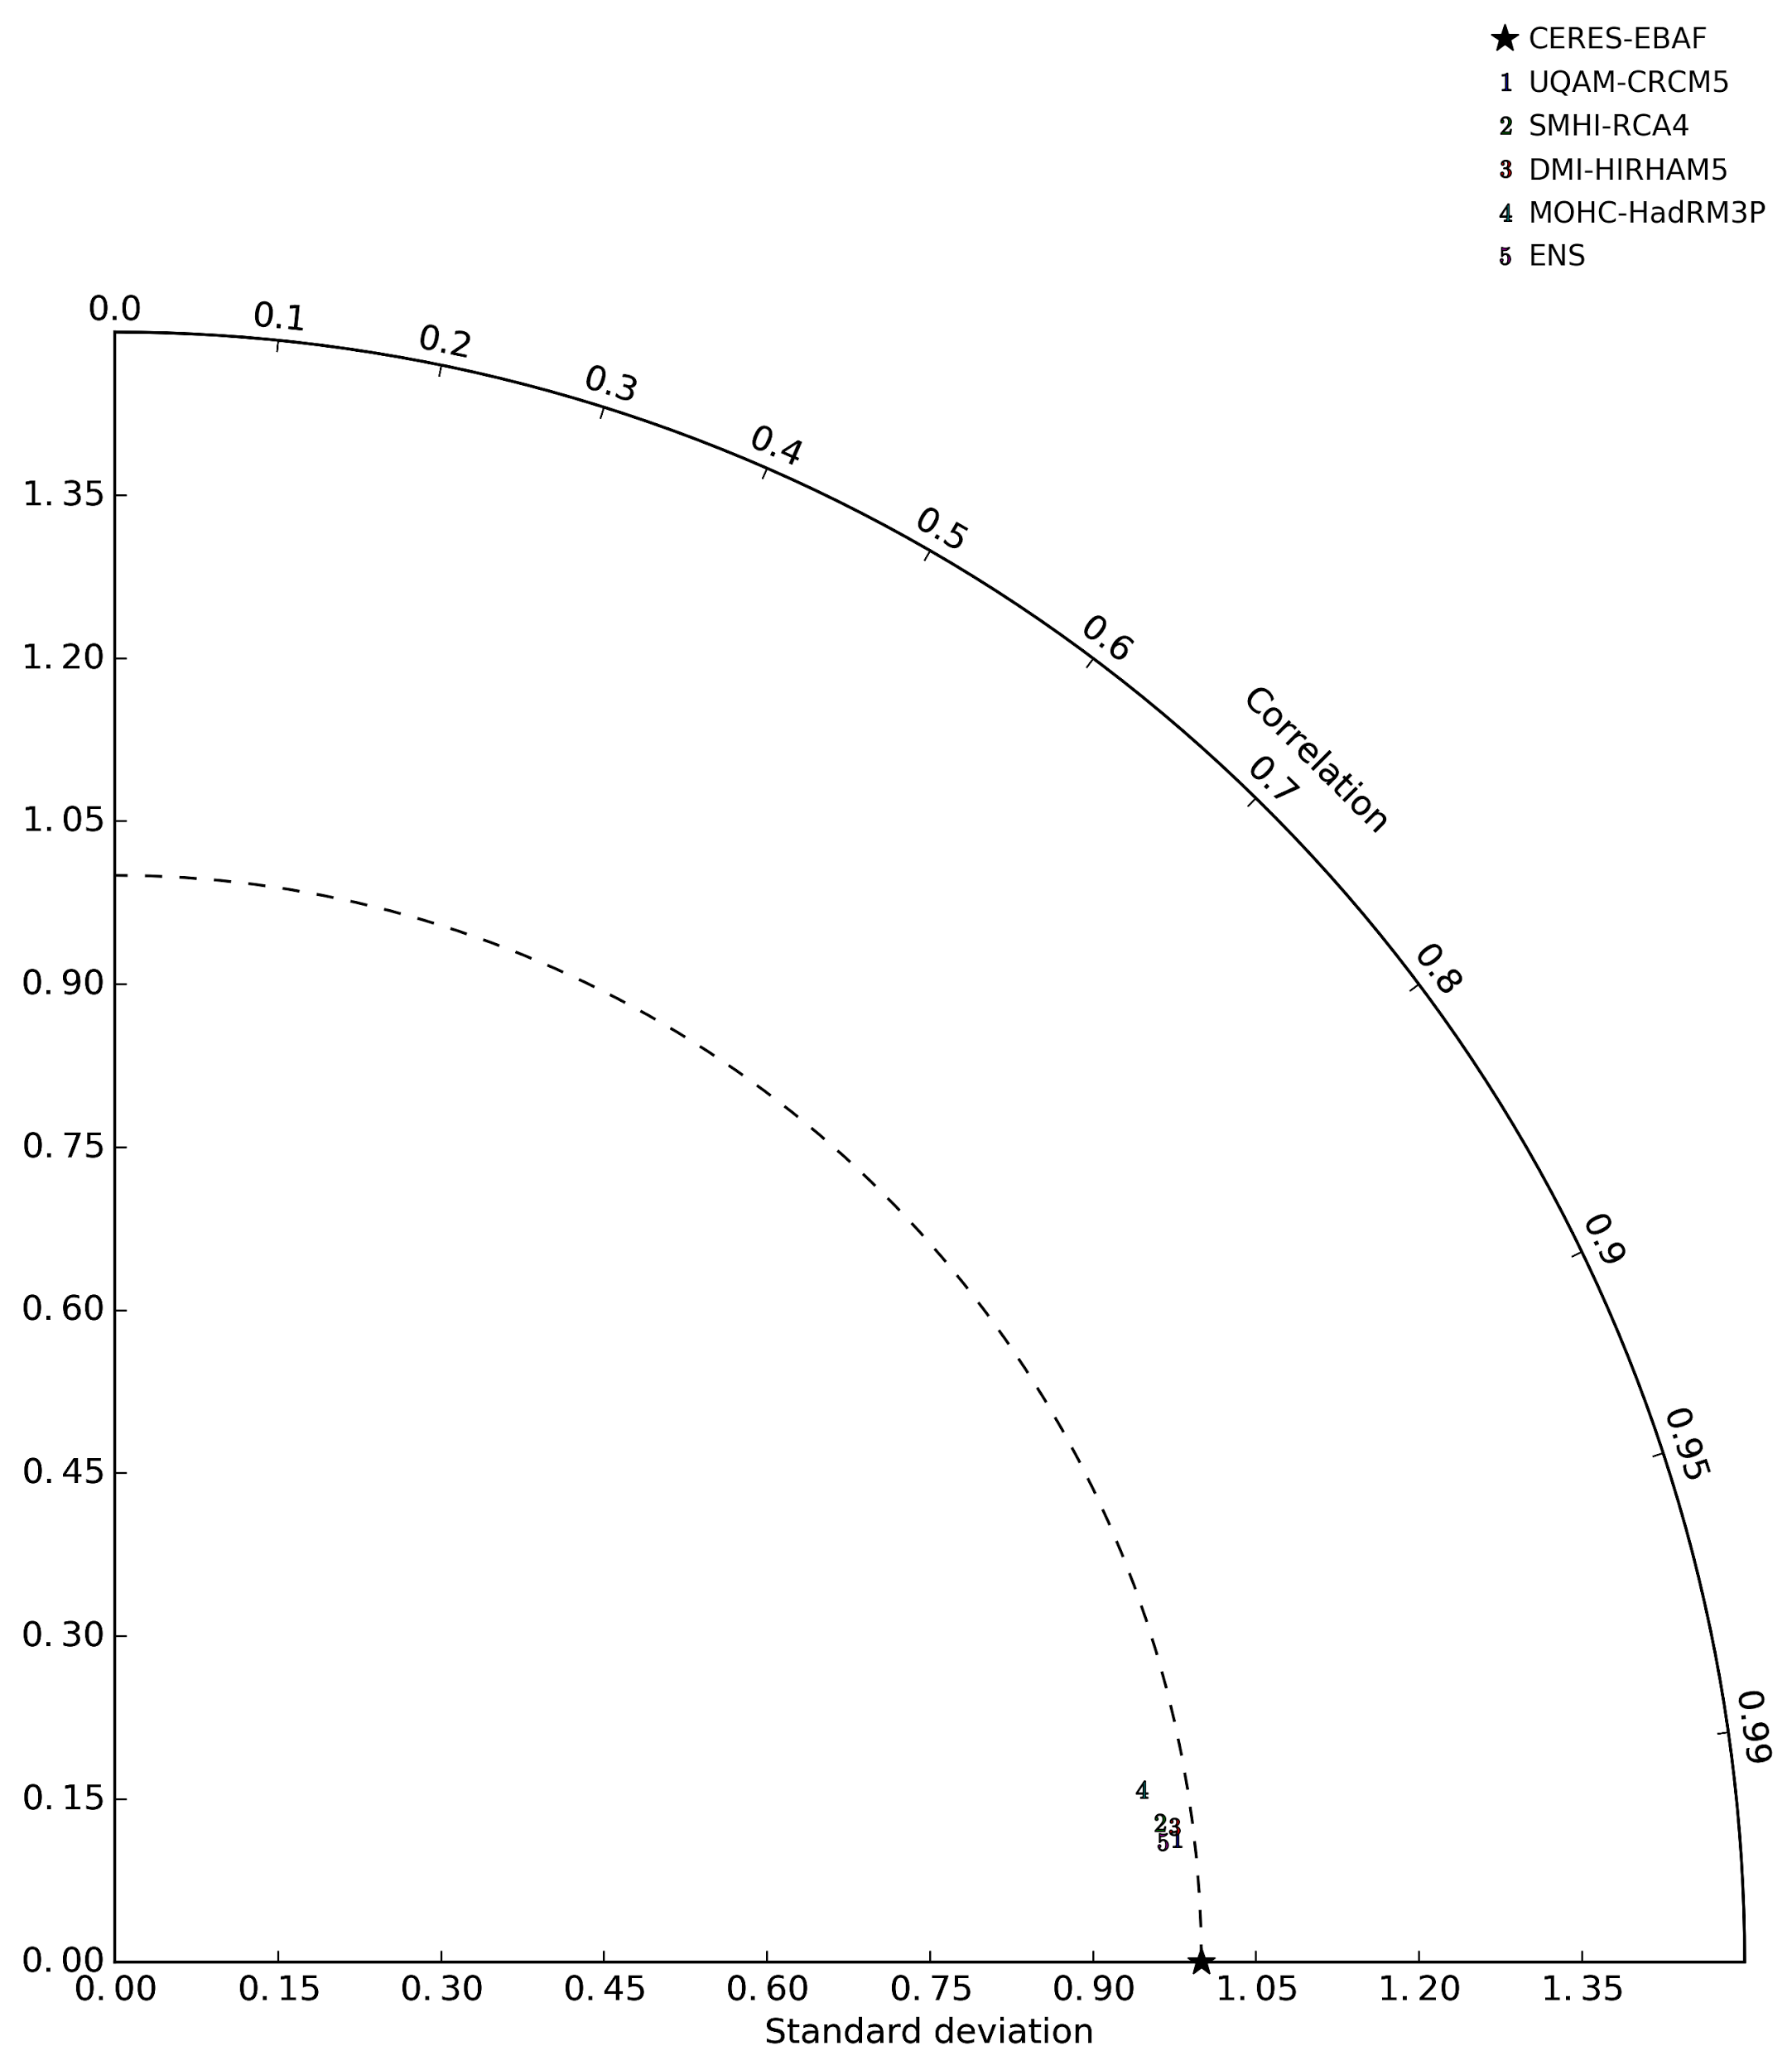
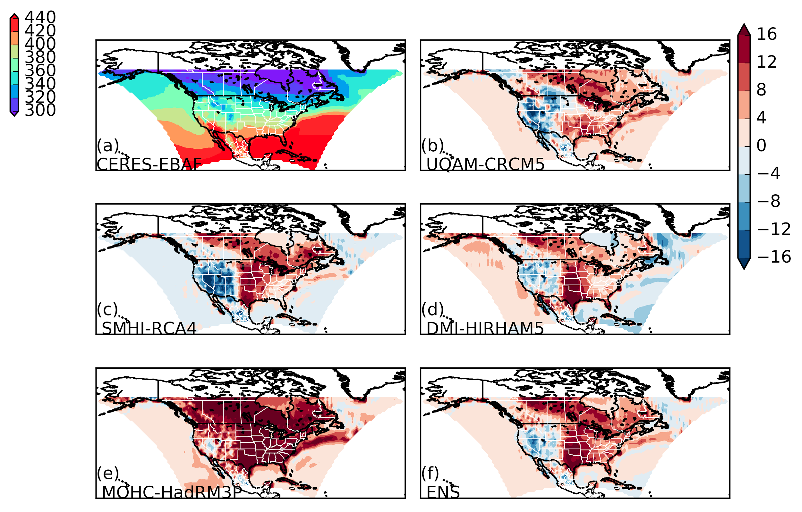
CERES Outgoing LW Surface Radiation (W/m²) (annual)
North America

Slide 11
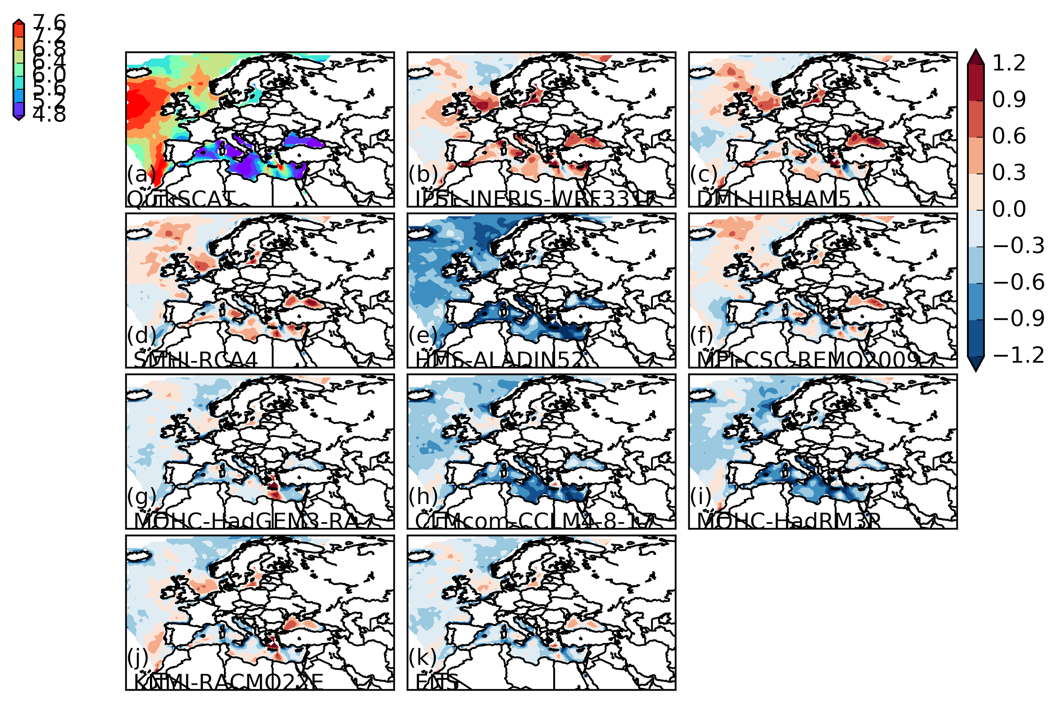
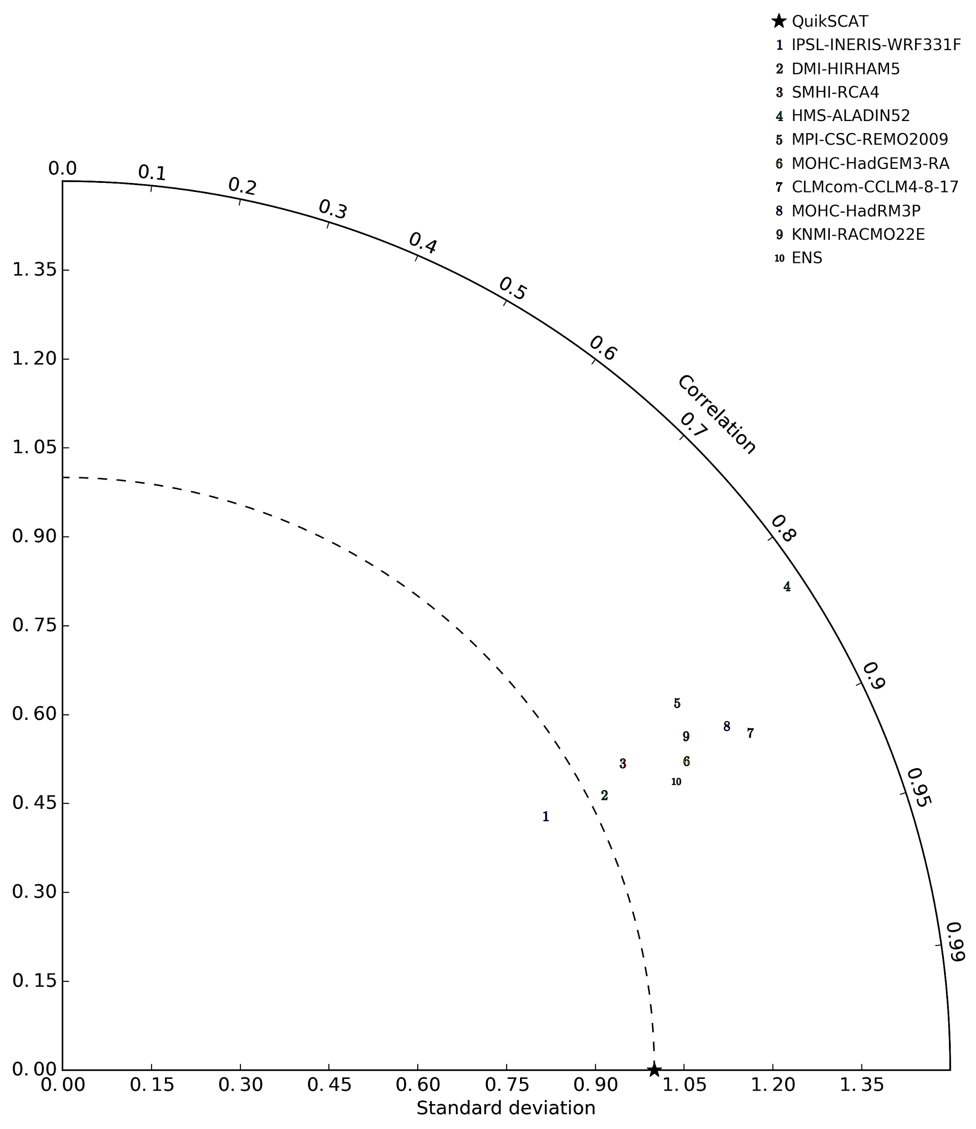
QuikSCAT Zonal Sea-Surface Wind (m/s) (summer)
Europe

Slide 12
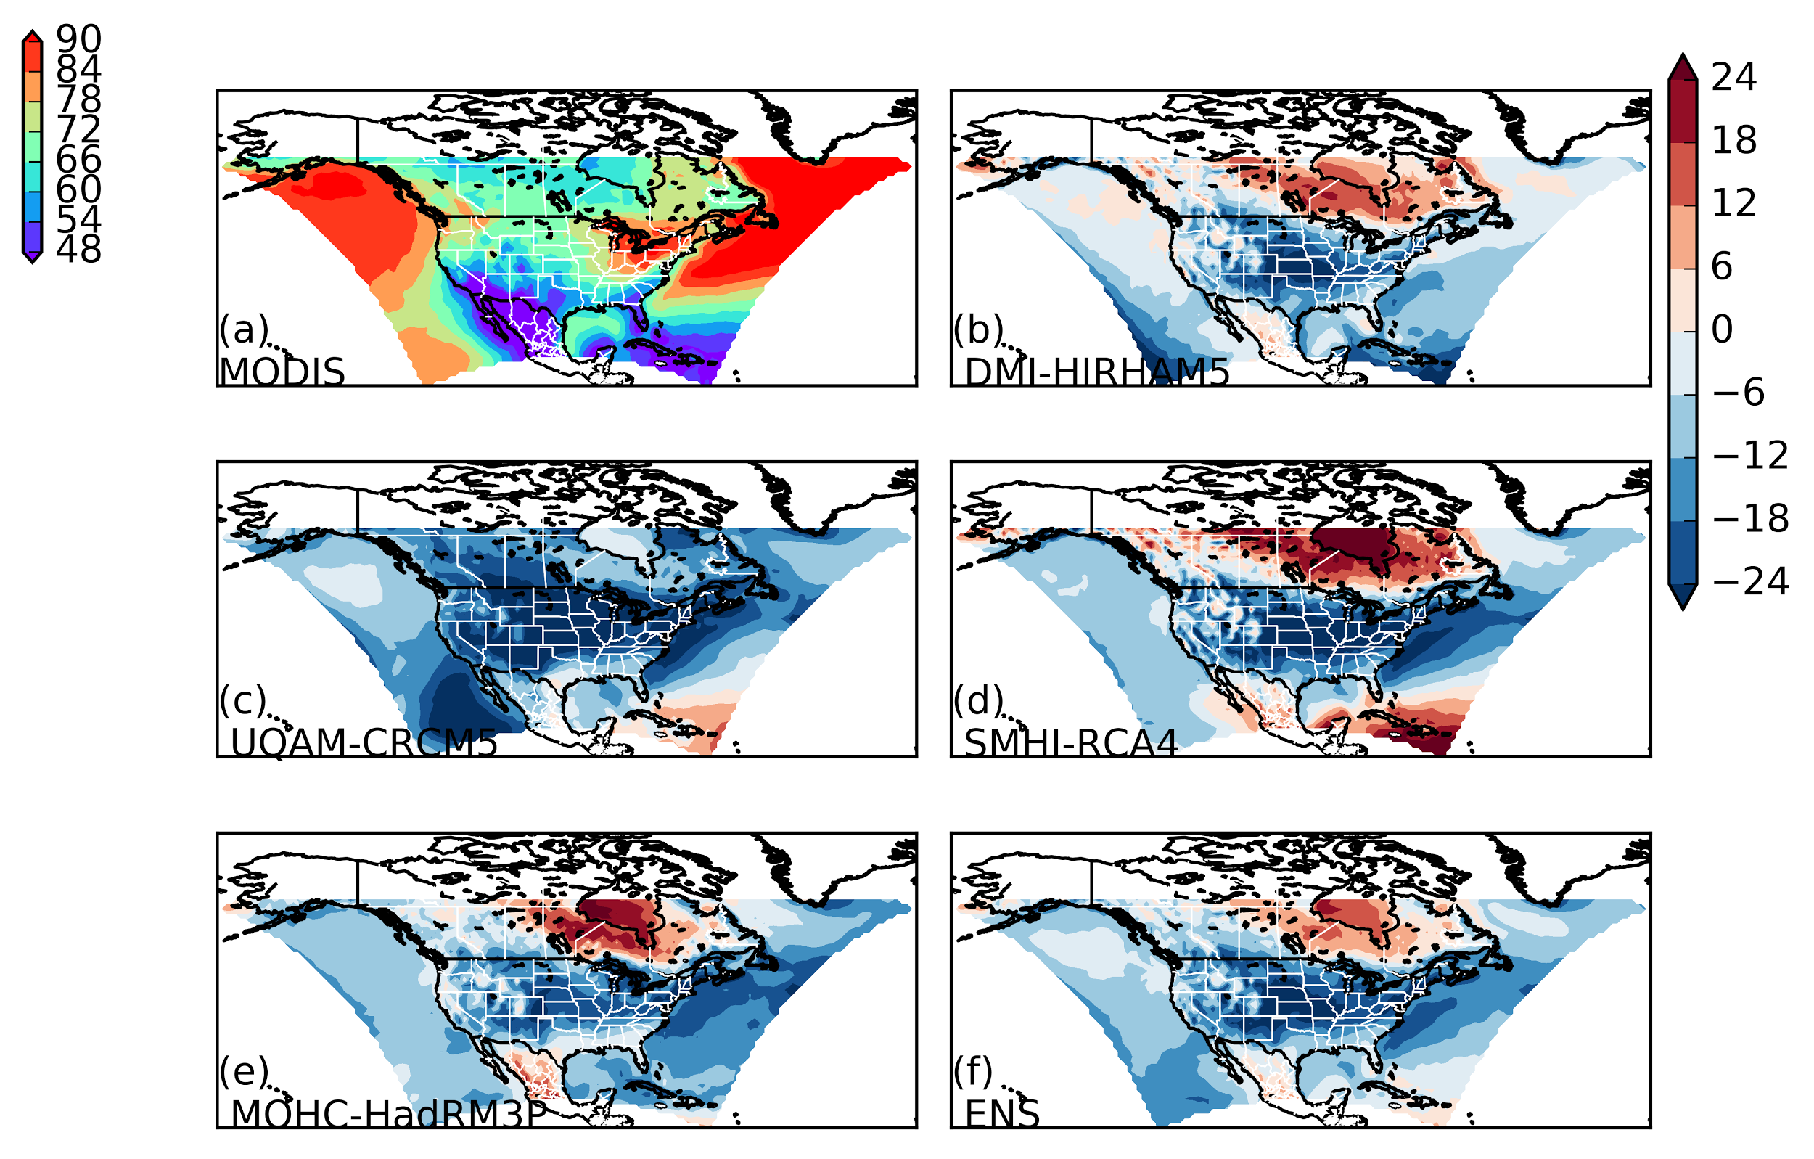
MODIS Total Cloud Fraction (%) (winter)
North America

Slide 13
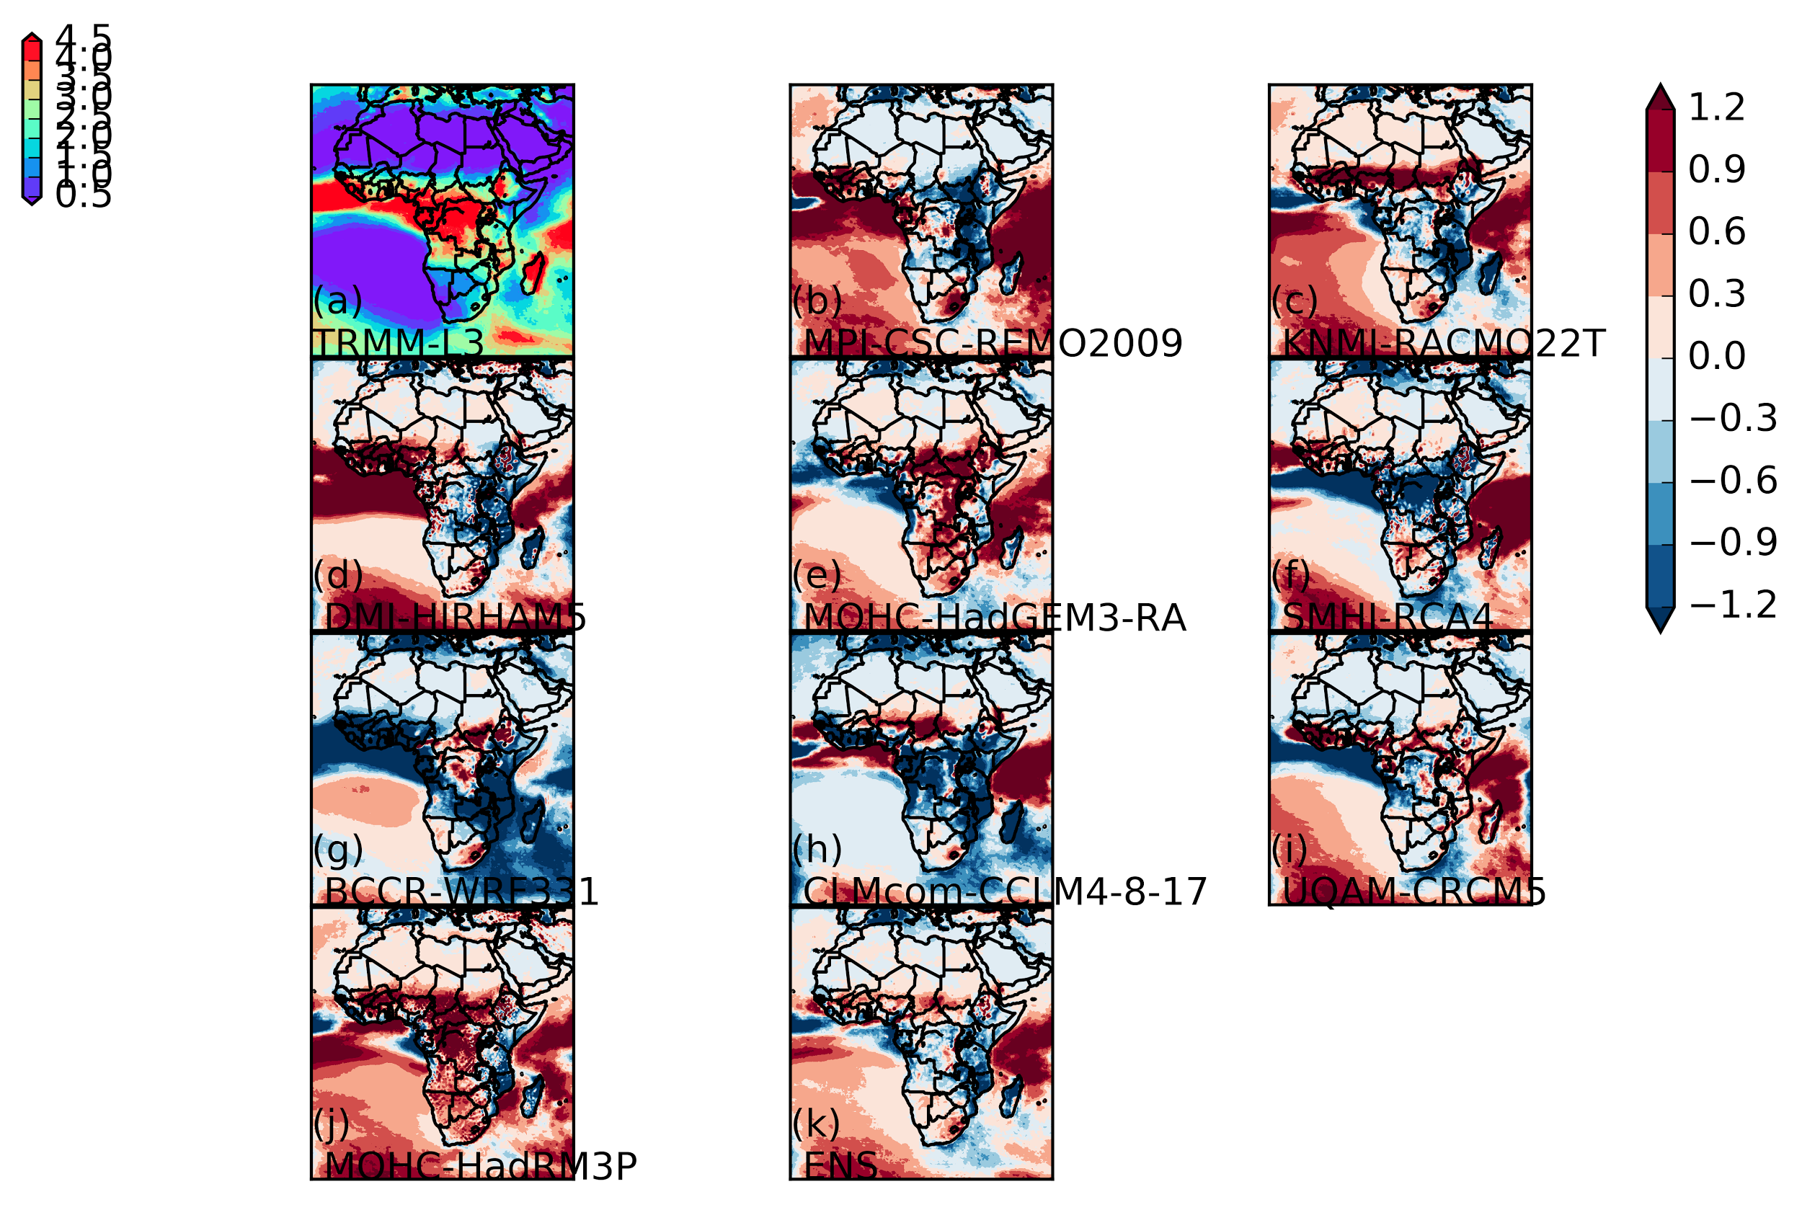
TRMM Precipitation (mm/month) (annual)
Africa

Slide 14
Analysis Plan / Future Work
Initial Evaluations will focus on domains with the most simulations on the ESGF (present)
Publish these results on RCMES website (early 2018)
Inform CORDEX POI’s of result publication
Include analysis and configuration files for 3D Temperature and Humidity fields from AIRS.
Analyze and post remaining evaluations with simulations (not on ESGF but) made available to us (mid 2018)

