Slide 1


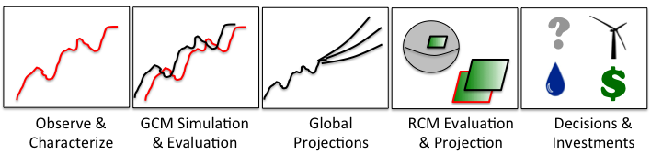
The Regional Climate Model Evaluation System (RCMES): Introduction and Demonstration
Jet Propulsion Laboratory
California Institute of Technology
Paul C. Loikith, Duane E. Waliser, Chris Mattmann, Jinwon Kim, Huikyo Lee, Paul M. Ramirez, Andrew F. Hart, Cameron E. Goodale, Michael J. Joyce, Shakeh E. Khudikyan, Maziyar Boustani, Kim Whitehall, Alex Goodman, Jesslyn Whittell, and Paul Zimdars
WCRP VAMOS/CORDEX Workshop on Latin-America and Caribbean CORDEX
LAC Phase II-Caribbean
April, 7-9, 2014
Santo Domingo, Dominican Republic
rcmes.jpl.nasa.gov

Slide 2
The Regional Climate Model Evaluation System (RCMES)
Jet Propulsion Laboratory
California Institute of Technology
Joint collaboration: JPL/NASA, UCLA
Designed to facility model evaluation and decision making
  Provides access to numerous (NASA) observation datasets (RCMED)
  Python-based built-in toolkit (RCMET) has regridding capabilities and calculates and visualizes several common metrics (RMSE, Bias)
  Connection to the Earth System Grid Federation allowing for access to CORDEX and CMIP5 models.
Initial target: CORDEX
rcmes.jpl.nasa.gov

Slide 3
RCMES Architecture
(http://rcmes.jpl.nasa.gov; Powered by Apache Open Climate Workbench)
Other Data Centers
(ESGF, DAAC, ExArch Network)
Model data
User
input
URL
TRMM
Metadata
Extract OBS data
Extract model data
MODIS
Data Table
Regridder
(Put the OBS & model data on the same time/space grid)
Data Table
Use the re-gridded data for user’s own analyses and VIS.
AIRS
Extractor for various data formats
Cloud Database
Data Table
Data extractor
(Binary or netCDF)
CERES
Data Table
Analyzer
Calculate evaluation metrics & assessment model input data
Soil moisture
Data Table
Data Table
Common Format,
Native grid,
Efficient architecture
Assess. modeling
ETC
Visualizer
(Plot the metrics)
Raw Data:
Various sources, formats,
Resolutions,
Coverage
RCMED
(Regional Climate Model Evaluation Database)
A large scalable database to store data from variety of sources in a common format
RCMET
(Regional Climate Model Evaluation Tool)
A library of code for extracting data from RCMED and model and for calculating evaluation metrics
Notes:
The standard RCMES diagram with some enhancements from Jinwon.

Slide 4

Evaluation of Cloud Computing for Storage & Application of NASA Observations
Jet Propulsion Laboratory
California Institute of Technology
Challenge
  Regional climate model evaluation with daily temporal resolution to assess representation of extreme events.
  More voluminous, requires scalability in web services, system throughput, and also elasticity based on study demands
Objective
  Understand and evaluate popular cloud computing technologies, and provide a framework for selecting the best one for supporting Regional Climate Model Evaluation System (RCMES) & applications such as the National Climate Assessment and IPCC’s CORDEX regional model evaluations.
Results
  Conducted evaluation demonstrating 44 %
  avg query time speedup of PostGIS over MySQL
  for 5 years of 5 parameters of obs data in RCMES
  Will incorporate into RCMES to facilitate NCA
  and CORDEX regional model evaluations.
C. Mattmann, D. Waliser, J. Kim, C. Goodale, A. Hart, P. Ramirez, D. Crichton, P. Zimdars, M. Boustani, H. Lee, P. Loikith, K. Whitehall, C. Jack, B. Hewitson. Cloud Computing and Virtualization Within the Regional Climate Model and Evaluation System. Earth Science Informatics, 2013.

Slide 5
Meet the RCMES Team
Jet Propulsion Laboratory
California Institute of Technology
Science Team:
Duane Waliser (PI, JPL/Caltech, UCLA), Jinwon Kim (UCLA),
Paul Loikith (JPL/Caltech), Huikyo Lee (JPL/Caltech),
Kim Whitehall (Howard University)
IT Team:
Chris Mattmann (PI, JPL/Caltech, UCLA), Paul Ramirez (JPL/Caltech),
Cameron Goodale (JPL/Caltech), Michael Joyce (JPL/Caltech),
Maziyar Boustani (JPL/Caltech), Andrew Hart (JPL/Caltech),
Shakeh Khudikyan (JPL/Caltech),
Jesslyn Whittel (University of California, Berkeley),
Alex Goodman (Colorado State University)
rcmes.jpl.nasa.gov

Slide 6
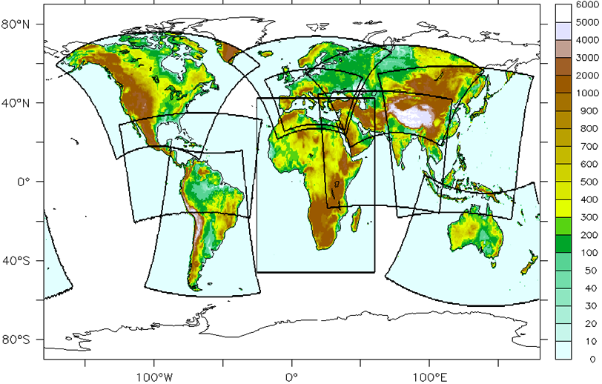
Active CORDEX Collaborations
Jet Propulsion Laboratory
California Institute of Technology
*
*
*
*
*
*
*
*
rcmes.jpl.nasa.gov

Slide 7
Observations
Remote Sensing, In Situ, Reanalysis
Jet Propulsion Laboratory
California Institute of Technology
Temperature (AIRS, CRU, UDEL)
Precipitation (TRMM, CRU, UDEL, CPC, GPCP)
Radiation/clouds (CERES, MODIS)
Sea surface height (AVISO)
Sea surface temperature (AMSRE)
Winds (QuikSCAT)
Multivariate reanalysis (MERRA, NARR, NLDAS, ERA-Interim)
More to come…
rcmes.jpl.nasa.gov

Slide 8
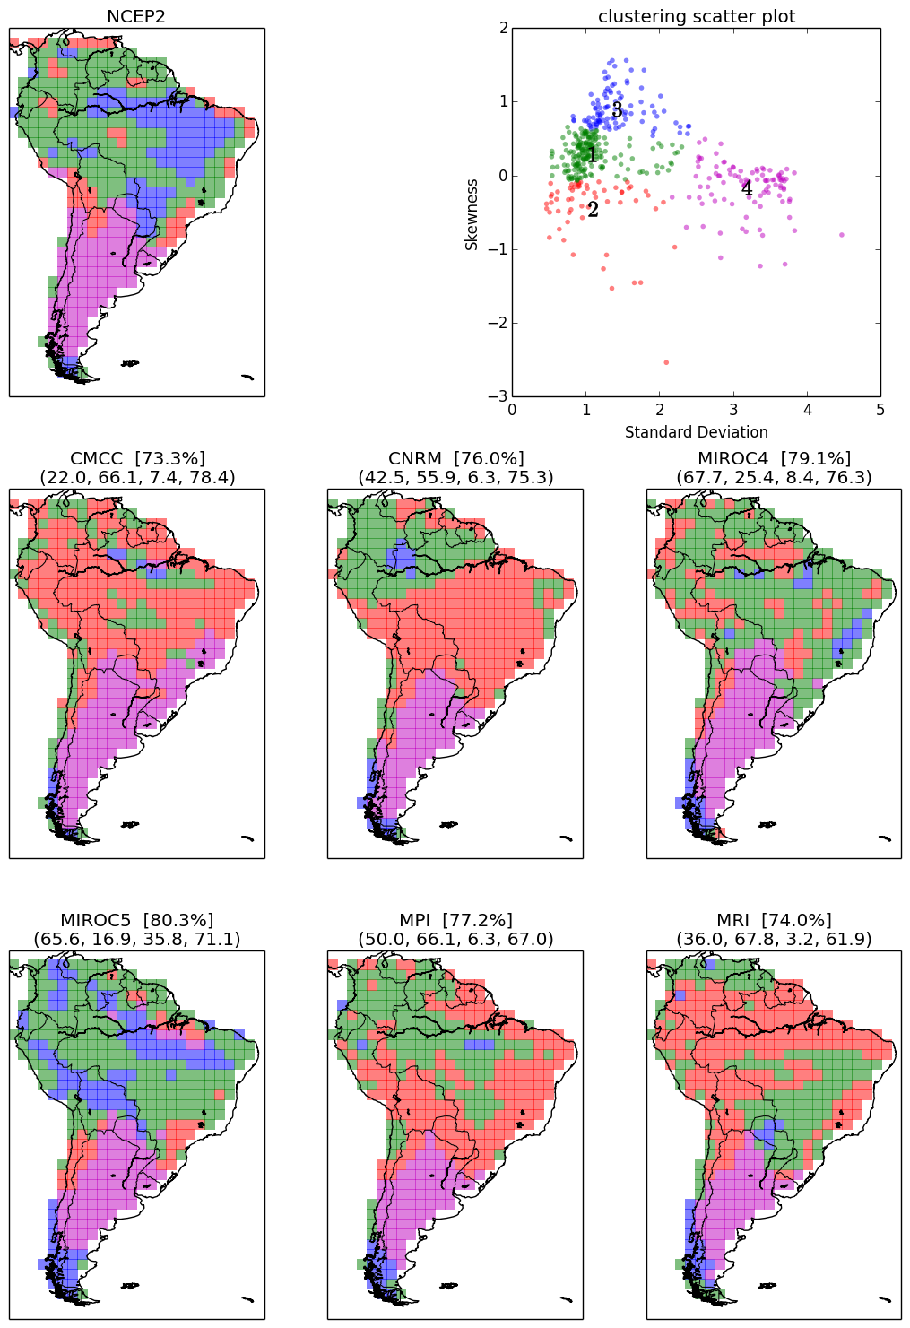
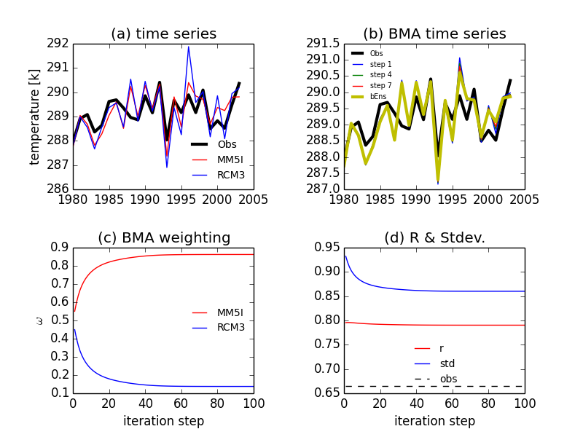
Ongoing Model Evaluation Studies
Jet Propulsion Laboratory
California Institute of Technology
Bayesian model averaging for optimal multi-model ensemble configurations.
(Huikyo Lee - lead)
Large scale meteorological patterns associated with temperature extremes over North America (Paul Loikith - lead )
K-means clustering to evaluate surface temperature variance and skewness over South America (Huikyo Lee - lead).

Slide 9
Ways to Use RCMES
Jet Propulsion Laboratory
California Institute of Technology
RCMES in a virtual machine environment
  Downloadable from rcmes.jpl.nasa.gov/downloads
  Comes with all Python libraries installed
RCMES open source code from Apache Open Climate Workbench
  Source code downloadable from http://climate.incubator.apache.org/
  Requires all necessary Python libraries installed on local machine
  Easily customizable, can interact easily with your own model/obs data
Available in command line and interactive users interface (UI) formats.
Downloading instructions available at rcmes.jpl.nasa.gov

Slide 10
Future Direction
Observations and metrics continue to be added to RCMES
  Community can contribute to RCEMT via the Apache Open Climate Workbench (http://climate.incubator.apache.org/)
Integration of metrics into the RCMES toolkit
Expanding user community and fostering new collaborations within CORDEX
rcmes.jpl.nasa.gov

Slide 11
RCMES Demonstration

Slide 12
Thank you!
Jet Propulsion Laboratory
California Institute of Technology
Contact information:
Paul Loikith: paul.c.loikith@jpl.nasa.gov
Duane Waliser: duane.e.waliser@jpl.nasa.gov (science PI)
Chris Mattmann: chris.a.mattmann@jpl.nasa.gov (IT PI)
  General questions: rcmes-general@jpl.nasa.gov
Websites:
rcmes.jpl.nasa.gov
rcmes.jpl.nasa.gov/downloads
  http://climate.incubator.apache.org/
Questions?

